Slide 1


RESEARCH ON APPLICATION OF MACHINE LEARNING METHODS FOR OPTIMIZATION OF BUSINESS PROCESSES
Mirmatlab Karimli, ISIfmu-24
(e-mail: mirmatlab.karimli@stud.vilniustech.lt)
Supervisor: Prof. Dr. Diana Kalibatienė
2025-06-25

Slide 2
Agenda
Problem Domain
Aim and Tasks
Introduction
Literature Review Results
Approach Presentation
Data Review
Main Conclusions
Future Works

Slide 3
Problem Domain
Problem
The problem domain of this project is forecasting drug sales in pharmacy stores using machine learning methods to improve inventory management and reduce medicine shortages, resulting in financial losses.
Object
The investigation object is machine learning techniques and their use in drug sales prediction.

Slide 4
Aim and Tasks
Aim:
The aim of this research is to enhance the accuracy of drug sales predictions in pharmacy stores by using machine learning techniques.
Tasks:
To analyze current machine learning frameworks and techniques for drug sales forecasting.
To propose a machine learning-based method for optimizing drug sales predictions in pharmacy stores.
To develop and evaluate a prototype of the suggested method and confirm its efficiency.

Slide 5
Introduction
Accurate drug sales forecasting is crucial for efficient inventory management in pharmacy stores. Traditional forecasting methods, like ARIMA, struggle with capturing the complexities of pharmaceutical sales data, particularly when accounting for seasonal variations and non-linear patterns. This project proposes a machine learning-based approach, using advanced techniques like XGBoost and LSTM, to improve prediction accuracy and optimize drug sales forecasting. By leveraging historical sales data and seasonality, this method aims to enhance inventory management and ensure pharmacies are well-prepared for future demand.

Slide 6
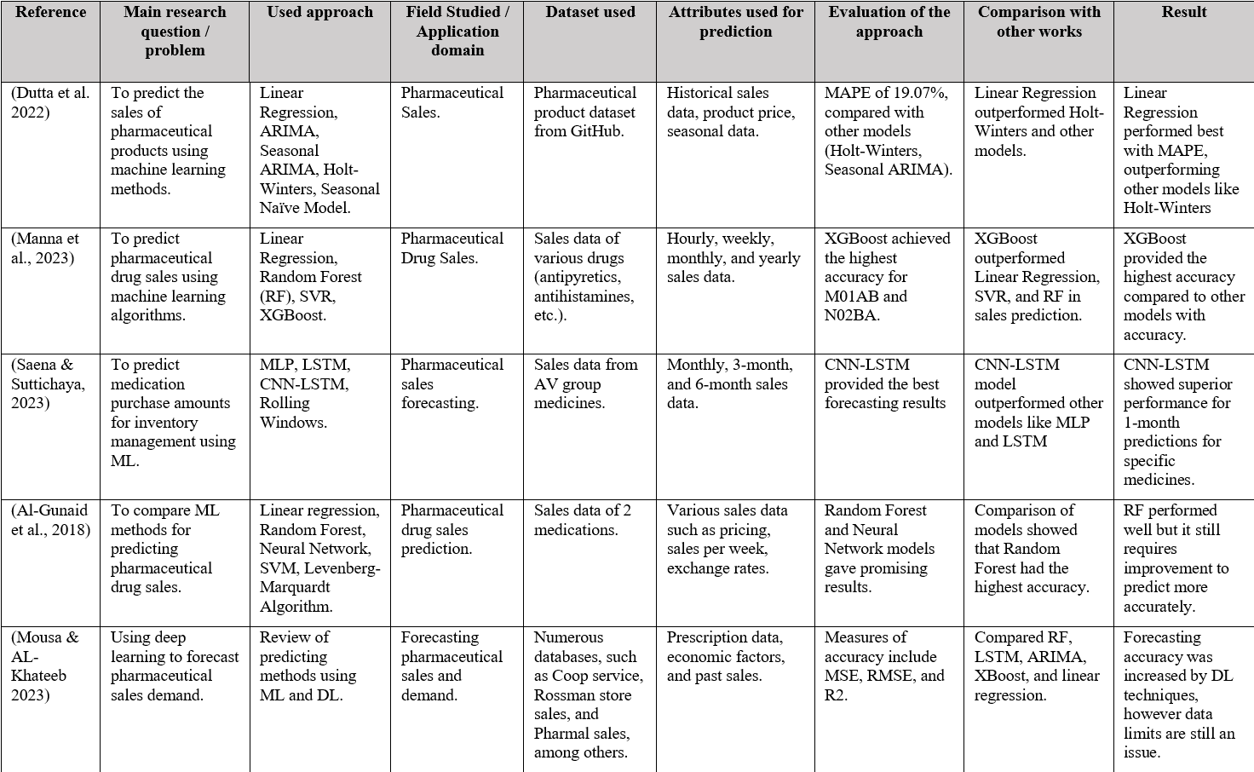
Literature Review Results

Slide 7
Literature Review Results
This table summarizes several studies related to forecasting pharmaceutical sales using various machine learning (ML) and deep learning (DL) techniques. It shows the methods used, datasets applied, and evaluation results for different models such as XGBoost, Random Forest (RF), and CNN-LSTM.

Slide 8
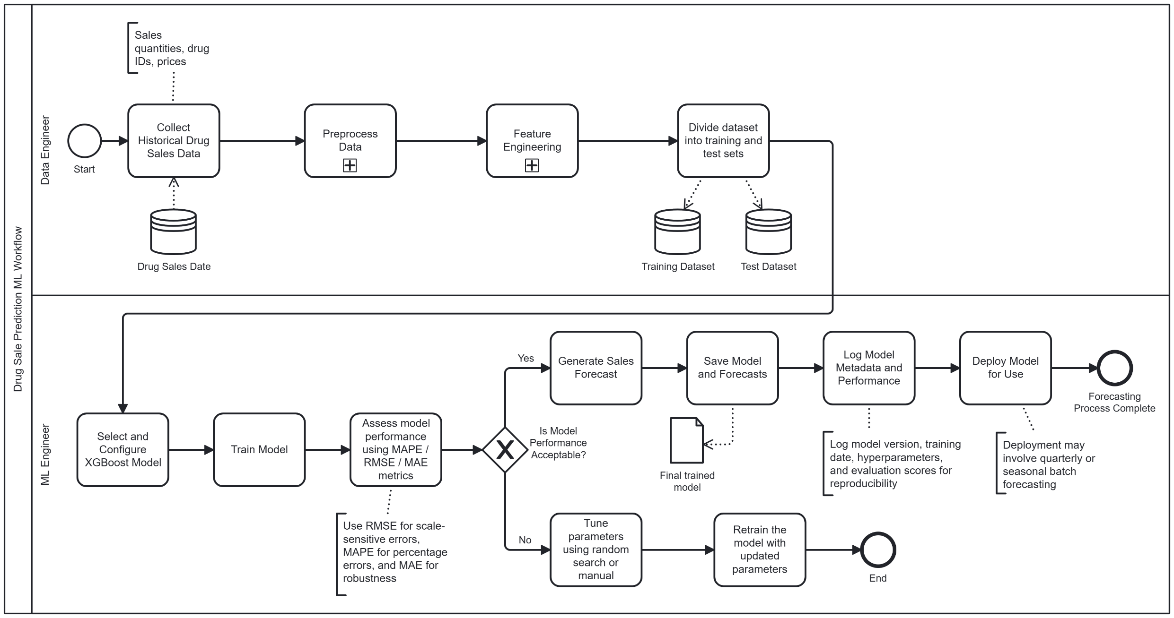
Approach Presentation
BPMN Diagram: Drug Sale Prediction using XGBoost (Seasonal Focus)

Slide 9
Approach Presentation
This BPMN diagram shows the workflow for predicting drug sales using the XGBoost model with a seasonal focus. The process starts with the Data Engineer, who collects and prepares historical sales data and creates useful features like season labels. Then, the ML Engineer trains the XGBoost model, evaluates its performance, and improves it if needed. Once the model performs well, it generates forecasts, which are saved, logged, and deployed for future use—usually in seasonal or quarterly cycles.

Slide 10
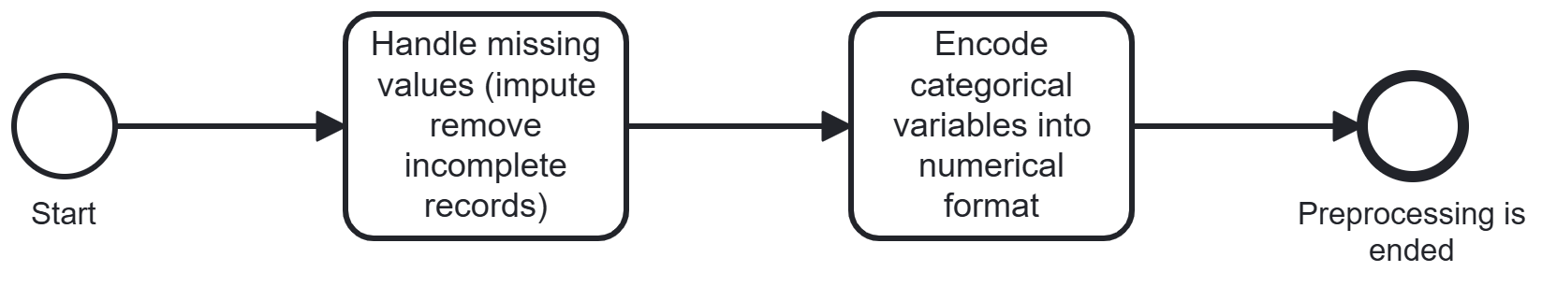
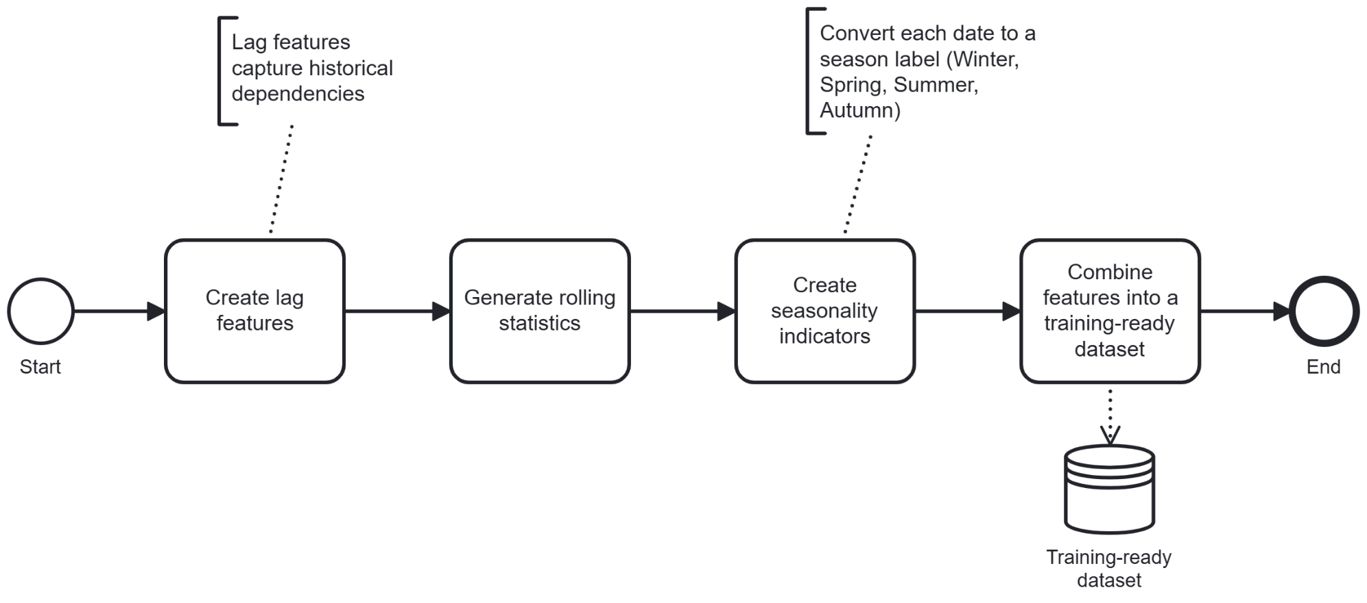
Approach Presentation
Subprocess: Preprocess Data
Subprocess:
Feature Engineering

Slide 11
Approach Presentation
In first subprocess, missing values are handled by either filling them or removing incomplete records. Then, categorical features are converted into numbers so that the machine learning model can understand them.
The second subprocess creates new features like lag values, rolling statistics, and season labels to help the model learn sales patterns. All features are then combined into a final dataset that is ready for training the machine learning model.

Slide 12
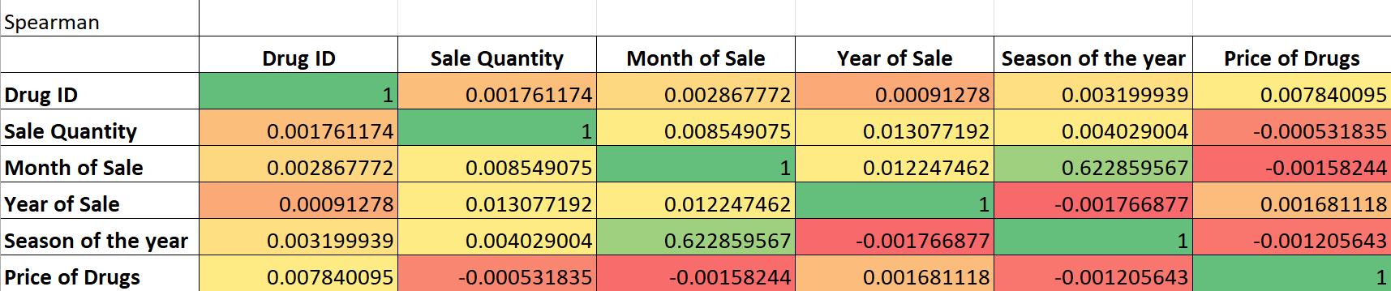
Dataset Review
This table presents the Spearman rank correlation between key features in the dataset, indicating the strength and direction of the monotonic relationships. Sale Quantity shows weak positive correlations with both Month of Sale and Year of Sale, suggesting a upward trend in sales over time, though these relationships are not strong. Season of the Year shows a positive correlation with Sale Quantity, indicating seasonal influence (higher sales are observed in some seasons). Price of Drugs has a very weak negative correlation with Sale Quantity, suggesting almost no impact of price on sales volume, meaning that drug sales are primarily influenced by factors other than price.

Slide 13
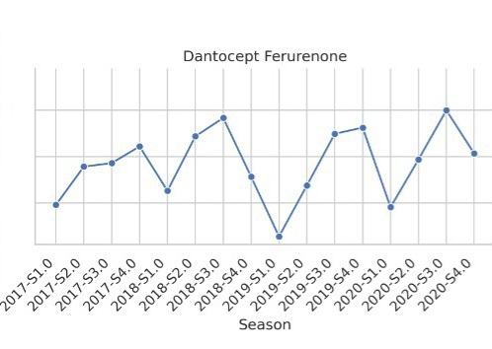
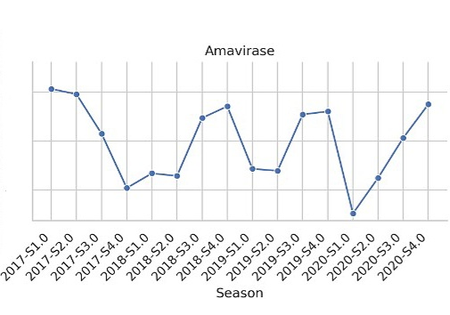
Drug Sale
Autumn
Summer
Sale Trend
This trends show that there are more demand for thise product during the season

Slide 14
Conclusion
Based on the analysis of current machine learning frameworks, it was found that traditional methods like ARIMA are not suitable for capturing complex drug sales patterns, especially seasonality and non-linearity.
For the first task, the analysis revealed that traditional models like ARIMA fail to handle complex relationships and seasonality in drug sales data.
For the second task, the proposed method using XGBoost and LSTM showed significant improvement in prediction accuracy by incorporating seasonal patterns and historical data.
In the third task, the developed prototype confirmed that the model outperforms traditional methods, proving its effectiveness in optimizing inventory management.
The main aim is improving drug sales predictions through machine learning, enhancing the forecasting process in pharmacies.

Slide 15
Future Work
Future work can focus on improving model accuracy by exploring additional machine learning algorithms, such as neural networks or ensemble methods. Incorporating external factors like weather and public health data could further refine forecasts.

Slide 16


Thank you for listening

